Slide 1
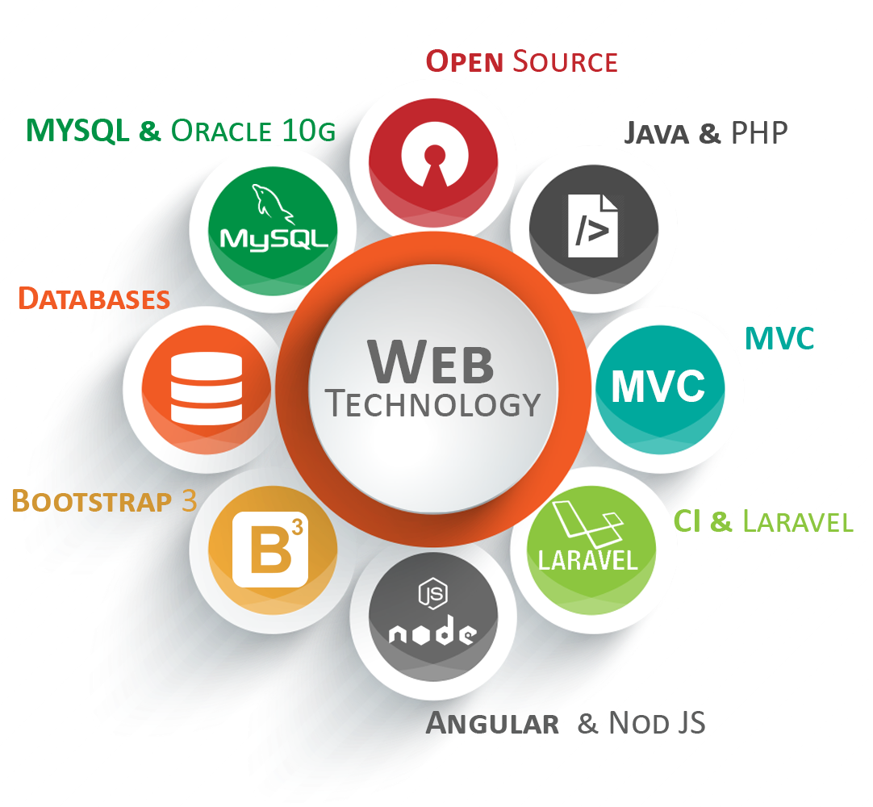
21AIM63 Web Technology Jimsha K Mathew SAP/AIML/NHCE

Slide 2
MODULE-IV
JavaScript
Client-Side Scripting, JavaScript Design Principles, Syntax, JavaScript Objects, The Document Object Model (DOM), JavaScript Events, Forms, Introduction to PHP, PHP Classes and Objects, Object-Oriented Overview, Classes and Objects in PHP, Error Handling and Validation, Errors and Exceptions.

Slide 3
Client-side vs. Server-side JavaScript
JavaScript can run on both web browsers and servers.
When JavaScript is used on a web page, it is executed in the user’s computers’ web browsers.
In this case, JavaScript works as a client-side language.
A popular JavaScript server-side environment is Node.js.
Unlike client-side JavaScript, server-side JavaScript executes on the server that allows you to access databases, file systems, etc.

Slide 4
What Can JavaScript Do?
JavaScript Can Change HTML Content
JavaScript Can Change HTML Attribute Values
JavaScript Can Change HTML Styles (CSS)
JavaScript Can Hide HTML Elements
JavaScript Can Show HTML Elements

Slide 5
A Simple JavaScript Program
<html>
<head>
<title>My First JavaScript code!!!</title>
<script type="text/javascript">
alert(“New Horizon College of Engineering");
</script>
</head>
<body>
</body>
</html>

Slide 6
JavaScript Variables
Declare Variables in JavaScript:
the keyword var to declare a variable.
For example: var name;
Assign a Value to the Variable.
Example var name = “JKM";
OR
var name;
name = “JKM";

Slide 7
JavaScript Variables - Example
<html>
<head>
<title>Variables!!!</title>
<script type="text/javascript">
var one = 22;
var two = 3;
var add = one + two;
var minus = one - two;
var multiply = one * two;
var divide = one/two;
document.write("First No: = " + one + "<br />Second No: = " + two + " <br />");
document.write(one + " + " + two + " = " + add + "<br/>");
document.write(one + " - " + two + " = " + minus + "<br/>");
document.write(one + " * " + two + " = " + multiply + "<br/>");
document.write(one + " / " + two + " = " + divide + "<br/>");
</script>
</head>
<body>
</body>
</html>

Slide 8
JavaScript Data Types
Data Types | Description | Example
String | represents textual data | 'hello', "hello world!" etc
Number | an integer or a floating-point number | 3, 3.234, 3e-2 etc.
BigInt | an integer with arbitrary precision | 900719925124740999n , 1n etc.
Boolean | Any of two values: true or false | true and false
undefined | a data type whose variable is not initialized | let a;
null | denotes a null value | let a = null;
Symbol | data type whose instances are unique and immutable | let value = Symbol('hello');
Object | key-value pairs of collection of data | let student = { };

Slide 9
JavaScript Data Types contd..
JavaScript is a dynamic language or loosely typed therefore a variable doesn’t associate with any type. However, its value does.
In other words, the same variable can hold values of different types at any time.
For example:
let counter = 10; // counter is a number
counter = true; // counter is now a boolean
counter = “VTU"; // counter is now a string

Slide 10
Difference Between =, ==, and === in JavaScript
Equal to (=) is an assignment operator, which sets the variable on the left of the = to the value of the expression that is on its right
Double equals (==) is a comparison operator, which transforms the operands having the same type before comparison.
=== (Triple equals) is a strict equality comparison operator in JavaScript, which returns false for the values which are not of a similar type.
This operator performs type casting for equality.
If we compare 2 with "2" using ===, then it will return a false value.

Slide 11
Difference Between =, ==, and === in JavaScript
= | == | ===
= in JavaScript is used for assigning values to a variable. | == in JavaScript is used for comparing two variables, but it ignores the datatype of variable. | === is used for comparing two variables, but this operator also checks datatype and compares two values.
It is called as assignment operator | It is called as comparison operator | It is also called as comparison operator
The assignment operator can evaluate to the assigned value | Checks the equality of two operands without considering their type. | Compares equality of two operands with their types.
It does not return true or false | Return true if the two operands are equal. It will return false if the two operands are not equal. | It returns true only if both values and data types are the same for the two variables.
= simply assign one value of variable to another one. | == make type correction based upon values of variables. | === takes type of variable in consideration.
== will not compare the value of variables at all. | The == checks for equality only after doing necessary conversations. | If two variable values are not similar, then === will not perform any conversion.

Slide 12

JavaScript Objects,
A javaScript object is an entity having state and behavior (properties and method). For example: car, pen, bike, chair, glass, keyboard, monitor etc.
JavaScript is an object-based language. Everything is an object in JavaScript.
JavaScript is template based not class based. Here, we don't create class to get the object. But, we direct create objects.
Creating Objects in JavaScript
There are 3 ways to create objects.
<script>
emp={id:102,name:"Shyam Kumar",salary:40000}
document.write(emp.id+" "+emp.name+" "+emp.salary);
</script>
By object literal
By creating instance of Object directly (using new keyword)
By using an object constructor (using new keyword)
1) JavaScript Object by object literal
The syntax of creating object using object literal is given below:
object={property1:value1,property2:value2.....propertyN:valueN}

Slide 13

2. By creating instance of Object
The syntax of creating object directly is given below:
var objectname=new Object();
Let’s see the example of creating object directly.
<script>
var emp=new Object();
emp.id=101;
emp.name="Ravi Malik";
emp.salary=50000;
document.write(emp.id+" "+emp.name+" "+emp.salary);
</script>

Slide 14

3) By using an Object constructor
Here, you need to create function with arguments. Each argument value can be assigned in the current object by using this keyword.
The this keyword refers to the current object.
The example of creating object by object constructor is given below.
<script>
function emp(id,name,salary)
{
this.id=id;
this.name=name;
this.salary=salary;
}
e=new emp(103,"Vimal Jaiswal",30000);
document.write(e.id+" "+e.name+" "+e.salary);
</script>

Slide 15
JavaScript Syntax
JavaScript syntax is the set of rules, how JavaScript programs are constructed:
JavaScript Values
JavaScript syntax defines two types of values:
Fixed values
Variable values
Fixed values are called Literals. Eg:10.50,”NHCE”
Variable values are called Variables. Eg: let x; x=7;
JavaScript Operators
JavaScript uses arithmetic operators (+,-,*,/) to compute values
Eg:(5+6)*10
JavaScript Expressions
An expression is a combination of values, variables, and operators, which computes to a value.
Eg: x * 10

Slide 16
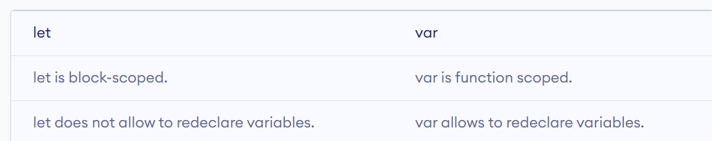
JavaScript Syntax
JavaScript Keywords
JavaScript keywords are used to identify actions to be performed. The let,var keyword tells the browser to create variables:
Eg:
let x, y; x = 5 + 6; y = x * 10;
Eg:
var x, y; x = 5 + 6; y = x * 10;

Slide 17
JavaScript Syntax
JavaScript Comments
Code after double slashes // or between /* and */ is treated as comment.
Eg:let x = 5; // It will be executed // x = 6; It will NOT be executed
JavaScript Identifiers / Names
Identifiers are JavaScript names. Identifiers are used to name variables and keywords, and functions.
A JavaScript name must begin with:
A letter (A-Z or a-z)
A dollar sign ($)
Or an underscore (_)
Subsequent characters may be letters, digits, underscores, or dollar signs.
JavaScript is Case Sensitive
The variables lastname and lastName are two different variables
JavaScript Character Set
JavaScript uses the Unicode character set. Unicode covers (almost) all the characters, punctuations, and symbols in the world.

Slide 18
Document Object Model
The Document Object Model (DOM) is a programming interface for HTML and XML documents.
The document object represents the whole html document.
The DOM is an object-oriented representation of the web page, which can be modified with a scripting language
such as JavaScript.
When html document is loaded in the browser, it becomes a document object.
It is the root element that represents the html document.
It has properties and methods.
With the help of document object, we can add dynamic content to our web page.
The DOM is a W3C (World Wide Web Consortium) standard.
According to W3C - "The W3C Document Object Model (DOM) is a platform and language-neutral interface that
allows programs and scripts to dynamically access and update the content, structure, and style of a document."
When a web page is loaded, the browser creates a Document Object Model of the page.

Slide 19
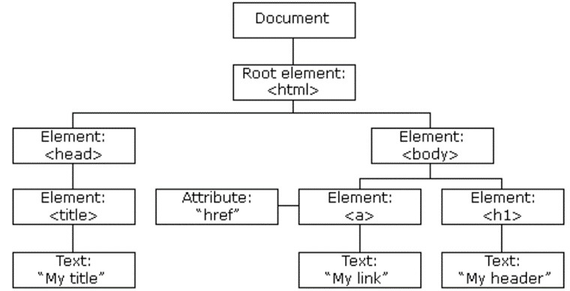
The DOM model is created as a tree of objects like this
JavaScript can access all the elements in a webpage making use of Document Object Model (DOM).
The web browser creates a DOM of the webpage when the page is loaded.

Slide 20
The W3C DOM standard
The W3C DOM standard is separated into 3 different parts:
Core DOM - standard model for all document types
XML DOM - standard model for XML documents
HTML DOM - standard model for HTML documents
What is the HTML DOM?
The HTML DOM is a standard object model and programming interface for HTML. It is a standard for how to get, change, add, or delete HTML elements. It defines:
The HTML elements as objects
The properties of all HTML elements
The methods to access all HTML elements
The events for all HTML elements
Properties of document object
HTML DOM methods are actions you
can perform (on HTML Elements).
HTML DOM properties are values (of HTML Elements) that you can set or change.

Slide 21
Changing the HTML Output Stream
Syntax to change the content of an HTML element:
document.getElementById(id).innerHTML = new HTML
Example:
<!DOCTYPE html>
<html>
<body>
<h4>Example - JavaScript can Change HTML</h4>
<p id="id-1">Engineering</p>
<script>
document.getElementById("id-1").innerHTML = "Computer Engineering";
</script>
</body>
</html>
Output
Engineering
Computer Engineering

Slide 22
Finding HTML Elements
Elements in the DOM can be selected by ID, class, or tag
Method | Description
document.getElementById(id) | Find an element by element id
document.getElementsByTagName(name) | Find elements by tag name
document.getElementsByClassName(name) | Find elements by class name
getElementById, innerHTML
The getElementById Method
The most common way to access an HTML element is to use the id of the element.
The innerHTML Property
The easiest way to get the content of an element is by using the innerHTML property.
The innerHTML property is useful for getting or replacing the content of HTML elements.
The innerHTML property can be used to get or change any HTML element, including <html> and <body>.

Slide 23
Finding HTML elements by id
<p id="id-1">Engineers</p>
<p id="id-2">Computer Science and Engineering</p>
<script>
var Element1 = document.getElementById("id-1");
var Element2 = document.getElementById("id-2");
document.write("Welcome to the world of " + Element1.innerHTML+"<br/>");
document.write("Welcome to the world of " + "<b>"+Element2.innerHTML+"<b/><br/>");
</script>
Output
Engineers
Computer Science and Engineering
Welcome to the world of Engineers
Welcome to the world of Computer Science and Engineering

Slide 24
Finding HTML elements by tag name
getElementsByTagName -
<p>Computer Science and Engineering</p>
<p>Electronics Engineering</p>
<p>Civil Engineering</p>
<p id="id-1"></p>
<p id="id-2"></p>
<p id="id-3"></p>
<script>
var tag1 = document.getElementsByTagName("p");
document.getElementById("id-1").innerHTML = 'Welcome to ' + tag1[0].innerHTML; document.getElementById("id-2").innerHTML = 'Welcome to ' + tag1[1].innerHTML; document.getElementById("id-3").innerHTML = 'Welcome to ' + tag1[2].innerHTML;
</script>
Output
Computer Science and Engineering Electronics Engineering
Civil Engineering
Welcome to Computer Science and Engineering
Welcome to Electronics Engineering Welcome to Civil Engineering

Slide 25
Finding HTML elements by class name
getElementsByClassName -
<p class="class-1">Engineering</p>
<p class="class-2">Computer</p>
<p id="id-1"></p>
<p id="id-2"></p>
<script>
var class1 = document.getElementsByClassName("class-1"); var class2 = document.getElementsByClassName("class-2");
document.getElementById("id-1").innerHTML = 'Welcome to ' + class1[0].innerHTML;
document.getElementById("id-2").innerHTML = class2[0].innerHTML+" Science and "+ class1[0].innerHTML;
</script>
Output Engineering Computer
Welcome to Engineering
Computer Science and Engineering

Slide 26
Changing the Value of an Attribute
Syntax to change the value of an HTML attribute:
document.getElementById(id).attribute = new value
This example changes the value of the src attribute of an <img> element:
<!DOCTYPE html>
<html>
<body>
<img id="id-1" src="Images/image1.png">
<script>
document.getElementById("id-1").src = "Images/image2.png";
</script>
</body>
</html>

Slide 27
Changing HTML Style
Syntax to change the style of an HTML element: document.getElementById(id).style.property = new style
The following example changes the style of a <p> element:
<html>
<body>
<p id="id-1">Computer Science and Engineering</p>
<script>
document.getElementById("id-1").style.color = "red";
</script>
</body>
</html>
Output
Computer Science and Engineering

Slide 28
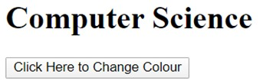
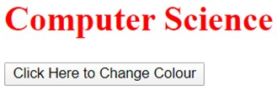
JavaScript Events
The HTML DOM allows you to execute code when an event occurs.
Events are generated by the browser when "things happen" to HTML elements:
When a user clicks the mouse
When a web page has loaded
When an image has been loaded
When the mouse moves over an element
When an input field is changed
When an HTML form is submitted
When a user strokes a key
<!DOCTYPE html>
<html>
<body>
<h1 id="id-1">Computer Science</h1>
<button type="button“ onclick="document.getElementById('id-1').style.color = 'red’”>
Click Here to Change Colour</button>
</body>
</html> Output

Slide 29
JavaScript Events
Mouse events:
Event Performed | Event Handler | Description
click | onclick | When mouse click on an element
mouseover | onmouseover | When the cursor of the mouse comes over the element
mouseout | onmouseout | When the cursor of the mouse leaves an element
mousedown | onmousedown | When the mouse button is pressed over the element
mouseup | onmouseup | When the mouse button is released over the element
mousemove | onmousemove | When the mouse movement takes place.

Slide 30
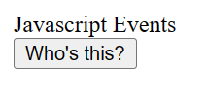
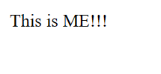
Click Event
<html>
<head> Javascript Events </head>
<body>
<script language="Javascript" type="text/Javascript">
function clickevent()
{
document.write("This is ME!!!");
}
</script>
<form>
<inputtype="button"value=“who’s this?” onclick="clickevent()"/>
</form>
</body>
</html>

Slide 31
MouseOver Event
<html>
<head>
<h1> Javascript Events </h1>
</head>
<body>
<script language="Javascript" type="text/Javascript">
function mouseoverevent()
{
alert("This is ME!!!");
}
</script>
<p onmouseover="mouseoverevent()"> Keep cursor over me</p>
</body>
</html>

Slide 32
Keyboard events:
Event Performed | Event Handler | Description
Keydown & Keyup | onkeydown & onkeyup | When the user press and then release the key

Slide 33
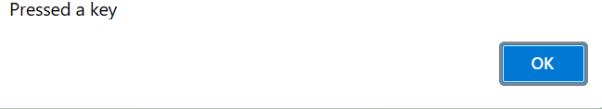
Keydown Event
<html>
<head> Javascript Events</head>
<body>
<h2> Enter something here</h2>
<input type="text" id="input1" onkeydown="keydownevent()"/>
<script>
function keydownevent()
{
document.getElementById("input1");
alert("Pressed a key");
}
</script>
</body>
</html>

Slide 34
Window/Document events
Event Performed | Event Handler | Description
load | onload | When the browser finishes the loading of the page
unload | onunload | When the visitor leaves the current webpage, the browser unloads it
resize | onresize | When the visitor resizes the window of the browser

Slide 35
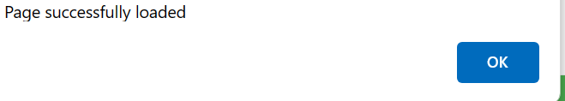
Load event
<html>
<head>Javascript Events</head>
</br>
<body onload="window.alert('Page successfully loaded');">
<script>
document.write("The page is loaded successfully");
</script>
</body>
</html>

Slide 36
Form events:
Event Performed | Event Handler | Description
focus | onfocus | When the user focuses on an element
submit | onsubmit | When the user submits the form
blur | onblur | When the focus is away from a form element
change | onchange | When the user modifies or changes the value of a form element

Slide 37

<!DOCTYPE html> <head> <meta charset="UTF-8"> <title> JavaScript Handling the Focus Event </title> </head> <body> <script> function highlightInput(elm)
{ elm.style.background = "lightgreen"; } </script> <input type="text" onfocus="highlightInput(this)"> <button type="button">Button</button> </body> </html>

Slide 38
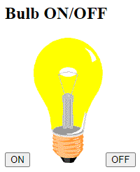
Bulb ON/OFF Program
<!DOCTYPE html>
<html>
<body>
<h2>Bulb ON/OFF</h2>
<script>
<button onclick="document.getElementById('myImage').src='pic_bulbon.gif'">ON</button>
<img id="myImage" src="pic_bulboff.gif" style="width:100px">
<button onclick="document.getElementById('myImage').src='pic_bulboff.gif'">OFF</button>
</script>
</body>
</html>

Slide 39
Forms in Javascript
Form name tag is used to define the name of the form. The name of the form here is "Login_form". This name will be referenced in the JavaScript form.
The action tag defines the action, and the browser will take to tackle the form when it is submitted. Here, we have taken no action.
The method to take action can be either post or get, which is used when the form is to be submitted to the server. Both types of methods have their own properties and rules.
The input type tag defines the type of inputs we want to create in our form. Here, we have used input type as 'text', which means we will input values as text in the textbox.
Next, we have taken input type as 'password' and the input value will be password.
Next, we have taken input type as 'button' where on clicking, we get the value of the form and get displayed.
submit (): The method is used to submit the form.
reset (): The method is used to reset the form values.

Slide 40
<html>
<body>
<form name=“login” onsubmit=“submitform()”>
<label>Username:</label>
<input type="text" id="username" name="username">
<br>
<label>password">Password:</label>
<input type="password" id="password" name="password">
<br>
<input type="submit" value="Login">
<input type=“reset“ value=“Reset">
</form>
<script>
Function submitform()
{
alert(“login successfully”);
}
</script></body></html>

Slide 41
Form Get & Post Actions
When you need to pass some information from your browser to web server and ultimately to your backend program.
The browser uses two methods to pass this information to web server.
These methods are GET method and POST method.
GET method:
The GET method sends the encoded user information appended to the page request.
The page and the encoded information are separated by the ? Character as follows:
http://www.sample.com/hello? key1=value1 & key2=value2
The GET method is the default method to pass information from browser to webserver and it produces a long string that appears in your browsers location :box.
The GET method should not be used if you have password or other sensitive information to pass to the server. For eg:
http://www.sample.com/test/serverfile? uid=abc & pwd=123.
Servlet handles this type of request using doGet() method.

Slide 42
POST method
It is a more reliable method of passing information to a backend program.
In the POST method, the URL visible to the user is just
http://www.sample.com/test/serverfile,
This packages the information in exactly the same way as GET method ,but instead of sending it as a text string after ? in the URL; it sends it as a separate message.
This message comes to the backend program in the form of the standard input which we can parse and use for our processing.
Servlet handles this type of request using doPost() method.
When the client submit the form by using the GET method, the servlets doGet() method is called to process the request.
When the client submit the form by using the POST method, the servlets doPost() method is called to process the request.

Slide 43
Built-in Objects
JavaScript built-in objects are :
Array
String

Slide 44
Array object
The Array object is used to store a set of values in a single variable name. We define an array object with the new keyword.
It has many methods that allows us to manipulate the values stored.
If we want to create an array of 10 elements then we can write,
var ar=new Array(10);
Using new operator we can allocate the memory dynamically for the arrays.
Here ar denotes the name of the array.
We can also create the array as:
var ar=new Array(10,20,30,40,50);

Slide 45
Array Methods
Push():-
add new elements to the end of an array and returns the new length.
For eg:
var num=[1,2,3,4,5];
document.write(num.push(6,7)); //return 7
document.write(num); //return 1,2,3,4,5,6,7
Pop():-
removes the last element.
Returns the poped element.
For eg:
Var num=[1,2,3,4,5];
document.write(num.pop()); //5
document.write(num); //return 1,2,3,4

Slide 46
Shift():-
Remove the first element from an array and returns the removed element .
For eg:
Var num=[1,2,3,4,5];
document.write(num.shift()); // return 1
document.write(num); //2,3,4,5
Splice ():-
To add or remove array elements.
Syntax for adding elements to an array:
Arrayname.splice(index,0,elt1,elt2…eltN)
Index->position from which elements to be added.
0->no. elements to be removed
Elt1,elt2….eltn-elements to be added.

Slide 47
Splice()
Syntax for removing elements from an array:
Arrayname.splice(index,Number)
Index->position from which elements to be removed.
Number->no. elements to be removed.
For eg:
Var num=[1,2,3,4,5];
num.splice(2,0,10,20,30);
document.write(num); // 1,2,10,20,30,3,4,5
num.splice (2,3);
document.write(num); //1,2,3,4,5

Slide 48
Sort():
Sort() method is used to arrange the array elements in some order.
By default,sort() method follows the ascending order.
var ar=[2,1,3,7,5];
var res=ar.sort();
document.write(res);
Reverse():
The reverse method reverses the elements in an array
var fruits=[“orange”,“apple”,”grapes”,”banana”];
document.write( fruits.reverse());

Slide 49
Introduction to Server-Side Development with PHP
PHP is an acronym for "PHP: Hypertext Preprocessor”
Originally PHP was short for “Personal Home Page” but over time it evolved to include that in its recursive current expansion “PHP: Hypertext Preprocessor”.
It is a widely-used, open source scripting language.
Server-side scripting languages interpret scripts on the server side rather than client-side (like JavaScript)
PHP code is executed on the server, and the result is returned to the browser as plain HTML
PHP files can contain text, HTML, CSS, JavaScript, and PHP code
PHP files have extension .php

Slide 50
Introduction to Server-Side Development with PHP
Current users of PHP include Joomla, Wikipedia, Yahoo!, Tumblr, and Slack.
Since PHP is a dynamically typed language, it’s also highly flexible.
It integrates with all the popular databases including MySQL, Postgres, Oracle, and MS SQL Server
PHP runs on various platforms(Windows, Linux, Unix, Mac OS X, etc.)
PHP can handle a wide range of data types.

Slide 51
what is Server-Side Development
Server side Programming
-program that runs on server dealing with the generation of content of web page
Querying the database 2) Operations over databases 3) Access/Write a file on server. 4) Interact with other servers. 5) Structure web applications. 6) Process user input.
For example if user input is a text in search box, run a search algorithm on data stored on server and send the results.

Slide 52
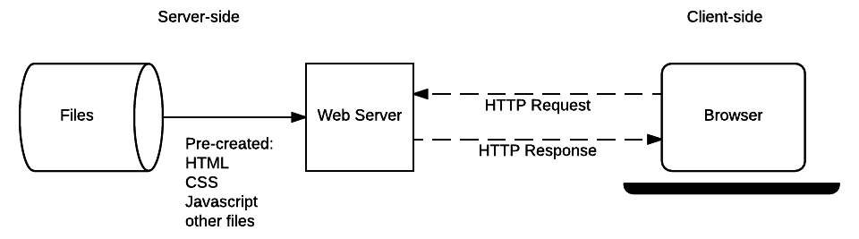
what is Server-Side Development
First, any web user is required to type the URL of the web page in the address bar of your web browser.
With the help of the URL, your web browser will fetch the IP address of your domain name either by converting the URL via DNS (Domain Name System) or by looking for the IP in cache memory. The IP address will direct your browser to the web server.
After making the connection, the web browser will request for the web page from the web server with the help of an HTTP request.
As soon as the web server receives this request, it immediately responds by sending back the requested page or file to the web browser HTTP.
If the web page requested by the browser does not exist or if there occurs some error in the process, the web server will return an error message.
If there occurs no error, the browser will successfully display the webpage.

Slide 53
A Web Server’s Responsibilities
Listens to client request continuously (HTTP Request).
Traps and takes client generated HTTP Request.
Passes the HTTP request to an appropriate web resource program of web application (deployed web application).
Provides container software to execute server side programs (web resource programs)
Gathers output generated by web resource programs.
Passes output of web resource programs to browser window as http response in the form of web page.
Provide environment to deploy manage and to undeploy the web application.

Slide 54
Quick Tour of PHP
PHP file contains HTML tags and some PHP scripting code.
To create a file , write HTML tags + PHP code and save this file with .php extension. PHP statements ends with semicolon (;).
All PHP code goes between the php tag. It starts with <?php and ends with ?>
<?php
//your code here
?>
Example:
<html>
<body>
<?php
echo "<h2>Hello First PHP</h2>";
?>
</body>
</html>

Slide 55
PHP Echo
PHP echo statement can be used to print the string, multi-line strings, escaping characters, variable, array, etc.
echo is a statement, which is used to display the output.
echo can be used with or without parentheses: echo(), and echo.
echo does not return any value.
We can pass multiple strings separated by a comma (,) in echo.
echo is faster than the print statement.
Example:
<?php
echo "Hello by PHP echo
this is multi line
text printed by
PHP echo statement
";
?>

Slide 56
PHP Variables
variable is declared using a $ sign followed by the variable name
we do not need to declare the data types of the variables. It automatically analyzes the values and makes conversions to its correct datatype.
After declaring a variable, it can be reused throughout the code.
Assignment Operator (=) is used to assign the value to a variable.
$variablename=value;
It can only contain alpha-numeric character and underscore (A-z, 0-9, _).
A variable name must start with a letter or underscore (_) character.
A PHP variable name cannot contain spaces.
One thing to be kept in mind that the variable name cannot start with a number or special symbols.
PHP variables are case-sensitive, so $name and $NAME both are treated as different variable.

Slide 57
Example:
<?php
$str="hello string";
$x=200;
$y=44.6;
echo "string is: $str <br/>";
echo "integer is: $x <br/>";
echo "float is: $y <br/>";
?>
string is: hello string
integer is: 200
float is: 44.6

Slide 58
PHP Data Types
PHP data types are used to hold different types of data or values. PHP supports 8 primitive data types that can be categorized further in 3 types:
Scalar Types (predefined)
Compound Types (user-defined)
Special Types
Scalar Types | Compound Types | Special Types
boolean integer float string | Array Object | resource NULL

Slide 59
PHP Boolean
- It holds only two values: TRUE (1) or FALSE (0).
PHP Integer
-numeric data with a negative or positive sign. Eg: $dec1 = 34;
PHP Float
number with a decimal point. $n1 = 19.34;
PHP String
-String values must be enclosed either within single quotes or in double quotes $College = “NHCE";
PHP Array
array is a compound data type. It can store multiple values of same data type in a single variable. $bikes = array ("Royal Enfield", "Yamaha", "KTM");
.

Slide 60
PHP Resource
Resources are not the exact data type in PHP. Basically, these are used to store some function calls or references to external PHP resources. For example - a database call. It is an external resource.
PHP Null
Null is a special data type that has only one value: NULL. There is a convention of writing it in capital letters as it is case sensitive.
The special type of data type NULL defined a variable with no value.
<?php
$nl = NULL;
echo $nl; //it will not give any output
?>

Slide 61
Program Control, Functions
PHP function is a piece of code that can be reused many times. It can take input as argument list and return value. There are thousands of built-in functions in PHP.
Syntax
function functionname(){
//code to be executed
}
Example
<?php
function sayHello(){
echo "Hello PHP Function";
}
sayHello();//calling function
?>
Output: Hello PHP Function

Slide 62
PHP supports Call by Value (default), Call by Reference, Default argument values and Variable-length argument list.
<?php
function sayHello($name){
echo "Hello $name<br/>";
}
sayHello("Sonoo");
sayHello("Vimal");
sayHello("John");
?>
Hello Sonoo
Hello Vimal
Hello John

Slide 63
PHP Call By Reference
To pass value as a reference, you need to use ampersand (&) symbol before the argument name.
<?php
function adder(&$str2)
{
$str2 .= 'Call By Reference';
}
$str = 'Hello ';
adder($str);
echo $str;
?>
Output:
Hello Call By Reference

Slide 64
Default Argument Value
We can specify a default argument value in function. While calling PHP function if you don't specify any argument, it will take the default argument.
<?php
function sayHello($name="Sonoo"){
echo "Hello $name<br/>";
}
sayHello("Rajesh");
sayHello();//passing no value
sayHello("John");
?>
Hello Rajesh
Hello Sonoo
Hello John

Slide 65
Returning Value
<?php
function cube($n){
return $n*$n*$n;
}
echo "Cube of 3 is: “,cube(3);
?>
Cube of 3 is: 27

Slide 66
PHP - What is OOP?
From PHP5, you can also write PHP code in an object-oriented style.
Object-Oriented programming is faster and easier to execute.

Slide 67
PHP - What is OOP?
Object-oriented programming has several advantages over procedural programming:
OOP is faster and easier to execute
OOP provides a clear structure for the programs
OOP helps to keep the PHP code DRY "Don't Repeat Yourself", and makes the code easier to maintain, modify and debug
OOP makes it possible to create full reusable applications with less code and shorter development time

Slide 68
Object Oriented Concepts:
Before we go in detail, lets define important terms related to Object Oriented Programming.
Class − This is a programmer-defined data type, which includes local functions as well as local data. You can think of a class as a template for making many instances of the same kind (or class) of object.
Object − An individual instance of the data structure defined by a class. You define a class once and then make many objects that belong to it. Objects are also known as instance.
Member Variable − These are the variables defined inside a class. This data will be invisible to the outside of the class and can be accessed via member functions. These variables are called attribute of the object once an object is created.

Slide 69
Member function − These are the function defined inside a class and are used to access object data.
Inheritance − When a class is defined by inheriting existing function of a parent class then it is called inheritance. Here child class will inherit all or few member functions and variables of a parent class.
Parent class − A class that is inherited from by another class. This is also called a base class or super class.
Child Class − A class that inherits from another class. This is also called a subclass or derived class.
Polymorphism − This is an object oriented concept where same function can be used for different purposes. For example function name will remain same but it take different number of arguments and can do different task.

Slide 70
Overloading − a type of polymorphism in which some or all of operators have different implementations depending on the types of their arguments. Similarly functions can also be overloaded with different implementation.
Data Abstraction − Any representation of data in which the implementation details are hidden (abstracted).
Encapsulation − refers to a concept where we encapsulate all the data and member functions together to form an object.
Constructor − refers to a special type of function which will be called automatically whenever there is an object formation from a class.
Destructor − refers to a special type of function which will be called automatically whenever an object is deleted or goes out of scope.

Slide 71
PHP - What are Classes and Objects?
Classes and objects are the two main aspects of object-oriented programming.
Look at the following illustration to see the difference between class and objects:
Class :Fruit objects
Apple
Banana
Mango

Slide 72
When the individual objects are created, they inherit all the properties and behaviors from the class, but each object will have different values for the properties.
When the individual objects (apple, banana, etc.) are created, they inherit all the properties and behaviors from the class, but each object will have different values for the properties.

Slide 73
Define a Class
A class is defined by using the class keyword, followed by the name of the class and a pair of curly braces ({}).
All its properties and methods go inside the braces:
<?php class Fruit { // code goes here... } ?>

Slide 74
Declaration:
Below we declare a class named Fruit consisting of two properties ($name and $color) and two methods set_name() and get_name() for setting and getting the $name property:
<?php class Fruit { // Properties public $name; public $color; // Methods function set_name($name) { $this->name = $name; } function get_name() { return $this->name; } } ?>

Slide 75
Define objects:
Classes are nothing without objects! We can create multiple objects from a class.
Each object has all the properties and methods defined in the class, but they will have different property values.
Objects of a class is created using the new keyword.
PHP - $this Keyword
The $this keyword refers to the current object, and is only available inside methods.
In the example below, $apple and $banana are instances of the class Fruit:

Slide 76
<?php class Fruit { // Properties public $name; public $color; // Methods function set_name($name) { $this->name = $name; } function get_name() { return $this->name; } } $appl = new Fruit(); $bana= new Fruit(); $appl->set_name('Apple'); $bana->set_name('Banana'); echo $appl->get_name(); echo "<br>"; echo $bana->get_name(); ?>

Slide 77
PHP – instanceof
You can use the instanceof keyword to check if an object belongs to a specific class:
<?php $apple = new Fruit(); var_dump($apple instanceof Fruit); ?>

Slide 78
PHP Error Handling
Error handling in PHP is simple. An error message with filename, line number and a message describing the error is sent to the browser.
When creating scripts and web applications, error handling is an important part. If your code lacks error checking code, your program may look very unprofessional and you may be open to security risks.
Different error handling methods:
Simple "die()" statements
Custom errors and error triggers

Slide 79
Basic Error Handling: Using the die() function
<?php $file=fopen("mytestfile.txt","r"); ?>
If the file does not exist you might get an error like this:
Warning: fopen(mytestfile.txt) [function.fopen]: failed to open stream:No such file or directory in C:\webfolder\test.php on line 2
To prevent the user from getting an error message like the one above, we test whether the file exist before we try to access it:

Slide 80
Basic error handling: Using die() function The die() function print a message and exit from current script.
Syntax:
die( $message )
<?php if(!file_exists("/tmp/test.txt"))
{
die("File not found");
}
else
{
$file = fopen("/tmp/test.txt","r");
print "Opend file sucessfully";
}
?>

Slide 81
Creating a Custom Error Handler
Creating a custom error handler is quite simple. We simply create a special function that can be called when an error occurs in PHP.
This function must be able to handle a minimum of two parameters (error level and error message) but can accept up to five parameters (optionally: file, line-number, and the error context):
Syntax
error_function(error_level,error_message,error_file,error_line,error_context)

Slide 82
Parameter | Description
error_level | Required. Specifies the error report level for the user-defined error. Must be a value number. See table below for possible error report levels
error_message | Required. Specifies the error message for the user-defined error
error_file | Optional. Specifies the filename in which the error occurred
error_line | Optional. Specifies the line number in which the error occurred
error_context | Optional. Specifies an array containing every variable, and their values, in use when the error occurred

Slide 83
Error Report levels
Value | Constant | Description
1 | E_ERROR | A fatal run-time error. Execution of the script is stopped
2 | E_WARNING | A non-fatal run-time error. Execution of the script is not stopped
8 | E_NOTICE | A run-time notice. The script found something that might be an error, but could also happen when running a script normally
256 | E_USER_ERROR | A fatal user-generated error. This is like an E_ERROR, except it is generated by the PHP script using the function trigger_error()
512 | E_USER_WARNING | A non-fatal user-generated warning. This is like an E_WARNING, except it is generated by the PHP script using the function trigger_error()
1024 | E_USER_NOTICE | A user-generated notice. This is like an E_NOTICE, except it is generated by the PHP script using the function trigger_error()
2048 | E_STRICT | Not strictly an error.
8191 | E_ALL | All errors and warnings (E_STRICT became a part of E_ALL in PHP 5.4)

Slide 84
ERROR | EXCEPTION
Error are the procedural approach. | Exceptions are an object-oriented approach to programming.
The default error handling in PHP is very simple. An error message with filename, line number and a message describing the error is sent to the browser. | Exceptions are used to change the normal flow of a script if a specified error occurs.
This can be done using php die() Function. | Basic Exception Handling using throw new Exception() in case of advance Exception handling youn have to use try and catch method.
Errors are mostly caused by the environment in which program is running. | Program itself is responsible for causing exceptions.

Slide 85
Error: An Error is an unexpected program result, which can not be handled by the program itself. That can be solved by using the issue in the code manually. An Error can be an infinite loop that can not be handled by the program itself so you have to manually repair that issue. There is an easy procedure to handle error i.e. using die() function. Exception: An Exception also is an unexpected result of a program but Exception can be handled by the program itself by throwing another exception. Exceptions should only be used with error conditions, where the error is non removal. There is an easy way to overcome the Exception by using try and catch method.
Exceptions Vs Errors in PHP
Syntax:
try
{
}
catch
{
}

Slide 86
PHP Exception Handling
Exceptions are used to change the normal flow of a script if a specified error occurs.
What is an Exception
With PHP 5 came a new object oriented way of dealing with errors.
Exception handling is used to change the normal flow of the code execution if a specified error (exceptional) condition occurs. This condition is called an exception.
This is what normally happens when an exception is triggered:
The current code state is saved
The code execution will switch to a predefined (custom) exception handler function
Depending on the situation, the handler may then resume the execution from the saved code state, terminate the script execution or continue the script from a different location in the code

Slide 87
Handling methods:
Basic Use of Exceptions:
When an exception is thrown, the code following it will not be executed, and PHP will try to find the matching "catch" block.
If an exception is not caught, a fatal error will be issued with an "Uncaught Exception" message.
Lets try to throw an exception without catching it:
<?php //create function with an exception function checkNum($number) { if($number>1) { throw
new Exception("Value must be 1 or below"); } return true; } //trigger exception checkNum(2); ?>

Slide 88
The code above will get an error like this:
Fatal error: Uncaught exception 'Exception' with message 'Value must be 1 or below' in C:\webfolder\test.php:6 Stack trace: #0 C:\webfolder\test.php(12): checkNum(28) #1 {main} thrown in C:\webfolder\test.php on line 6

Slide 89
IMPORTANT QUESTIONS
Write a PHP program to greet the user based on time.
Explain how an array acts as an ordered map in PHP.
What are superglobal variables? Explain any five superglobal variables
Explain a)$this keyword b)instanceof in PHP
What is a constructor. Demonstrate constructor with suitable example.
Write a PHP program to demonstrate classes and objects in php.
Describe the relationship between keys and indexes in arrays.
How do you read or write a file on the server from PHP?
What classes of information are available via the $_SERVER superglobal array?
What is the role of error reporting in PHP? How should it differ for development sites compared to production sites?

Slide 90
Explain $_SERVER Array in detail
Explain $_GET and $_POST superglobal arrays
What is a class?Explain classes and objects in php
Illustrate how Errors are handled in PHP
How exceptions are handles in PHP.
Write a program to demonstrate error handling and exceptions in PHP.

Slide 91
IMPORTANT QUESTIONS
Write a JavaScirpt code that displays text “NHCE” with increasing font size in the interval of 100 ms in blue color, when the font size reaches 50 pt it should stop.
Explain a web server’s responsibility in detail
Write a php program to perform arithmetic operations a) addition b) subtraction c)multiplication d) division
What are server-side include files? Why are they important in PHP?
With relevant code segments, explain two approaches to embed PHP script in HTML
Explain two methods in JavaScript to access DOM nodes with examples
How does PHP allow variable names to be specified at run-time? Explain with an example

Slide 92
Explain Document object Model in detail.
Demonstrate program control and Function in PHP with an example.
Explain various syntax in Javascript with suitable example
Demonstrate Javascript objects
Explain a) getElementById(id) b) getElementsByTagName(name) c) getElementsByClassName(name) with example
Write javascript code to demonstrate changing values of attributes
Explain Javascript events with suitable examples
Design a registration form using Javascript.

